Slide 1
ADAPTIVE CONTINUOUS CONTROL OF SPACECRAFT ATTITUDE USING DEEP REINFORCEMENT LEARNING Review
2024718003
오민식

Slide 2
Contents
1. Background
2. Purposed Method
3. Experiment Result
4. Summary

Slide 3
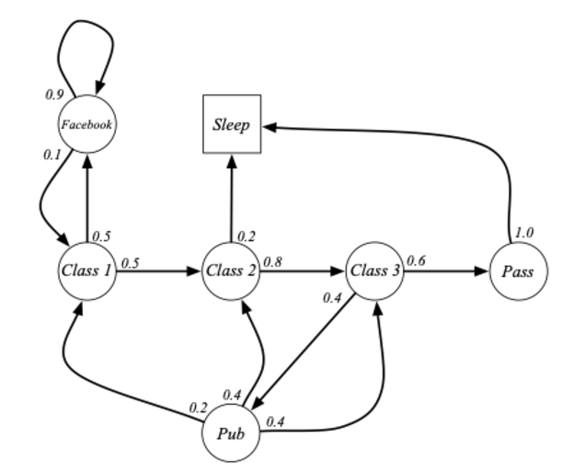
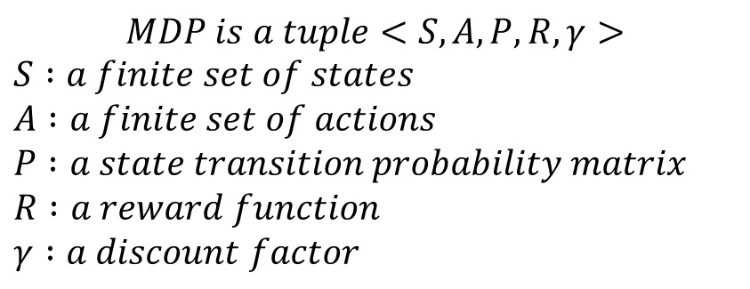
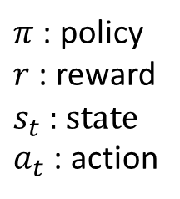
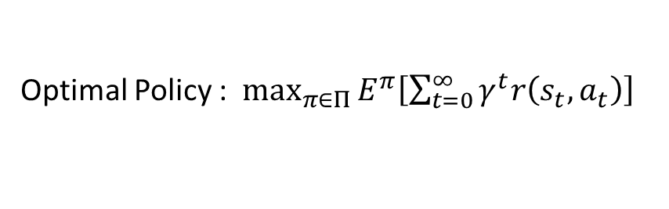
1. Background
MDP(Markov Decision Process) problem
: 현재 상태만이 미래의 영향을 준다는 가정 하에 “누적 보상을 최대”로 하기 위한
“최적의 정책”을 구하는 문제
$$MDP is a tuple<S,A,P,R,γ>$$
$$S :a finite set of states$$
$$A :a finite set of actions$$
$$P :a state transition probability matrix$$
$$R :a reward function$$
$$γ :a discount factor$$
Optimal Policy : $\max_{π∈Π}{E^{π}\left[\sum_{t=0}^{∞}{γ^{t}r\left(s_{t},a_{t}\right)}\right]}$
$π$ : policy
$r$ : reward
$s_{t}$ : state
$a_{t}$ : action
Figure 1. RL Course by David Silver - Lecture 2: Markov Decision Process

Slide 4
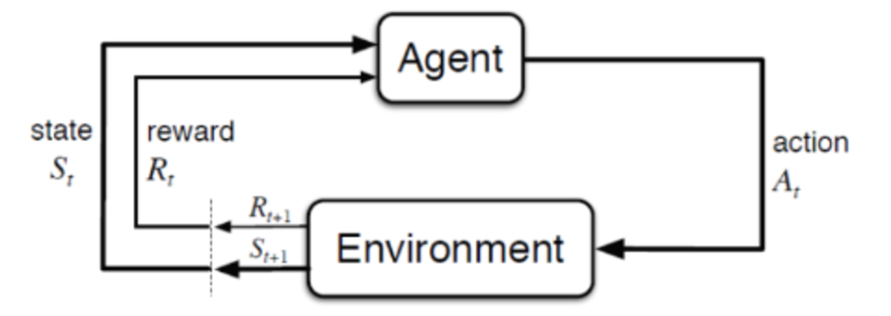
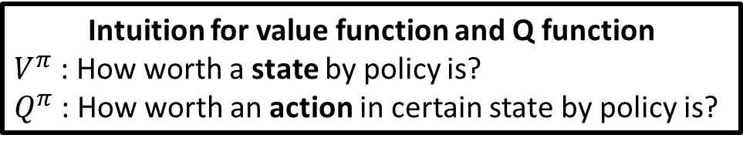
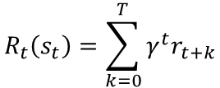
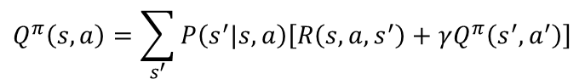
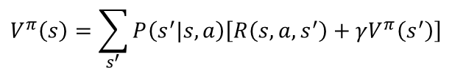
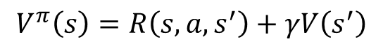
1. Background
Reinforcement Learning
Bellman Equation
$$R_{t}\left(s_{t}\right)=\sum_{k=0}^{T}{γ^{t}r_{t+k}}$$
$$V^{π}\left(s\right)=R\left(s,a,s^{′}\right)+γV\left(s^{′}\right)$$
$$V^{π}\left(s\right)=\sum_{s^{′}}{P\left(s^{′}|s,a\right)\left[R\left(s,a,s^{′}\right)+γV^{π}\left(s^{′}\right)\right]}$$
$$Q^{π}\left(s,a\right)=R\left(s,a,s^{′}\right)+γQ^{π}\left(s^{′},a^{′}\right)$$
$$Q^{π}\left(s,a\right)=\sum_{s^{′}}{P\left(s^{′}|s,a\right)\left[R\left(s,a,s^{′}\right)+γQ^{π}\left(s^{′},a^{′}\right)\right]}$$
현재 상태와 다음 상태간 최적의 경로를
찾기 위한 최적 방정식
Intuition for value function and Q function
$V^{π}$ : How worth a state by policy is?
$Q^{π}$ : How worth an action in certain state by policy is?
용어 정리
Agent : 학습 대상
Environment : 학습 환경(학습 조건 포함)
State : 학습 대상의 현재 상태
Action : 학습 대상의 행동
Reward : 학습 대상과 학습 환경 간 상호 작용
Figure 2. Schematic diagram for Reinforcement learning

Slide 5
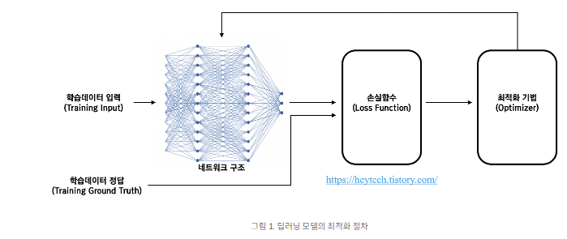
1. Background
Deep Reinforcement Learning (DRL) = RL + Deep learning
Figure 3. Deep Learning overview
강화학습 기법에 딥러닝을 결합한 방식.
“Environment” 내에서 “Reward”가 최대가 되도록 하는 “Policy”를 학습
학습 데이터 : episode 실행 데이터 (state, action, reward)
*episode : agent가 학습을 수행할 반복 횟수
DRL에서는 학습 데이터를 Agent 와 Environment가 상호작용한 데이터를 사용

Slide 6
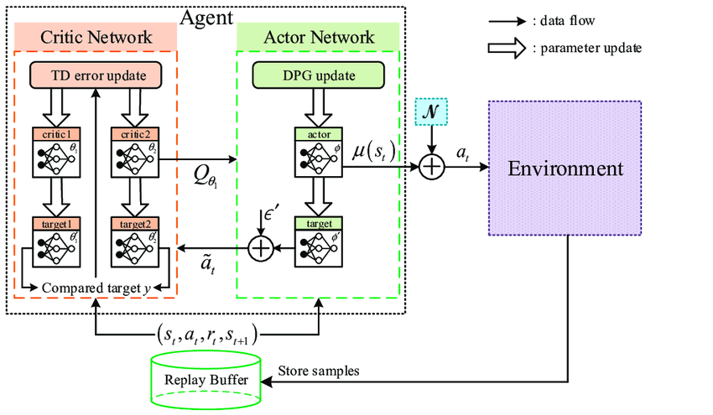
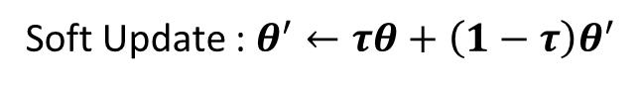
1. Background
TD3 : Twin Delayed Deep Deterministic policy gradient algorithm
Actor : direct policy training network
Critic : Q-learning training network
Replay Buffer : database about interaction between agent and environment
(Off-policy algorithm)
*On-policy : update during episode
*Off-policy : update at start of episode
Soft Update : $θ^{′}←τθ+\left(1−τ\right)θ^{′}$
Fig 4. TD3 Architecture
Feature
Two Q-network : Prevention overestimation of Q- value
Update Frequency : Critic network > Actor network => accurate training
(Normally 2 : 1)
3. Policy smoothing : Noise addition to action => action stabilization
4. Soft Update : control rapid network change

Slide 7
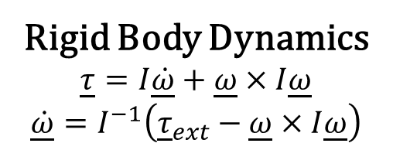
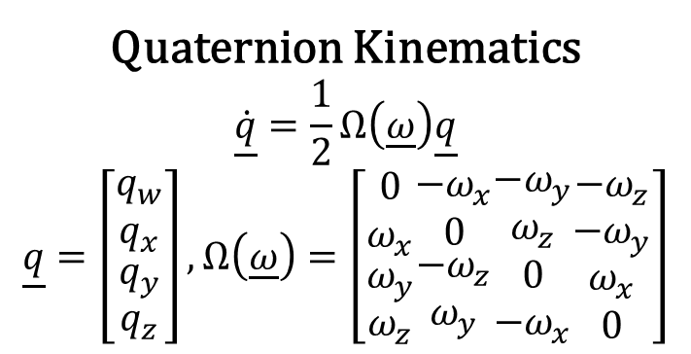
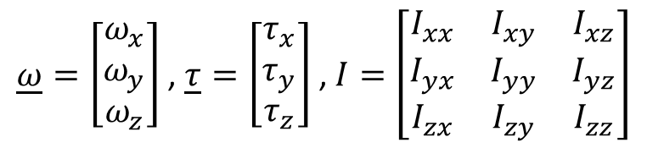
1. Background
Rigid Body Dynamics
$$\underline{τ}=I\underline{\dot{ω}}+\underline{ω}×I\underline{ω}$$
$$\underline{\dot{ω}}=I^{−1}\left({\underline{τ}}_{ext}−\underline{ω}×I\underline{ω}\right)$$
Quaternion Kinematics
$$\underline{\dot{q}}=\frac{1}{2}Ω\left(\underline{ω}\right)\underline{q}$$
$$\underline{q}=\left[\begin{matrix}q_{w} \\ q_{x} \\ \begin{matrix}q_{y} \\ q_{z}\end{matrix}\end{matrix}\right],Ω\left(\underline{ω}\right)=\left[\begin{matrix}0 \\ ω_{x} \\ \begin{matrix}ω_{y} \\ ω_{z}\end{matrix}\end{matrix}\begin{matrix}−ω_{x} \\ 0 \\ \begin{matrix}−ω_{z} \\ ω_{y}\end{matrix}\end{matrix}\begin{matrix}−ω_{y} \\ ω_{z} \\ \begin{matrix}0 \\ −ω_{x}\end{matrix}\end{matrix}\begin{matrix}−ω_{z} \\ −ω_{y} \\ \begin{matrix}ω_{x} \\ 0\end{matrix}\end{matrix}\right]$$
$\underline{ω}=\left[\begin{matrix}ω_{x} \\ ω_{y} \\ ω_{z}\end{matrix}\right]$ , $\underline{τ}=\left[\begin{matrix}τ_{x} \\ τ_{y} \\ τ_{z}\end{matrix}\right]$ , $I=\left[\begin{matrix}I_{xx} & I_{xy} & I_{xz} \\ I_{yx} & I_{yy} & I_{yz} \\ I_{zx} & I_{zy} & I_{zz}\end{matrix}\right]$
Fig. 5. LM50 spacecraft model
with body-fixed frame labeled
Fig. 6. Relationship between desired attitude
and Body-fixed frame

Slide 8
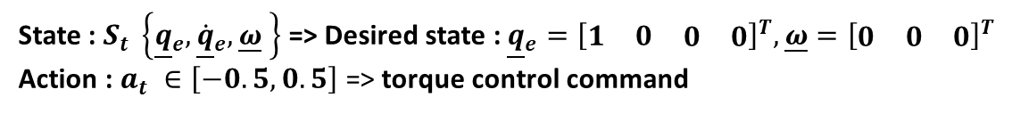
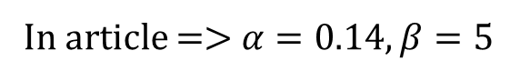
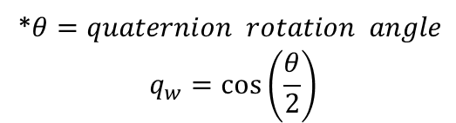
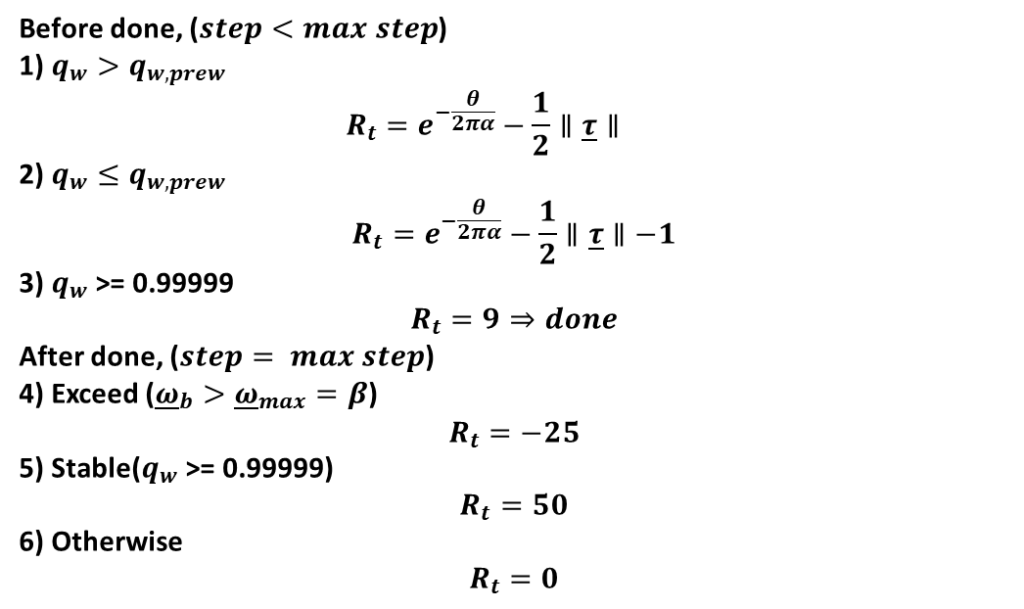
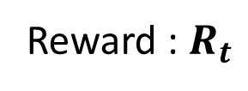
2. Purposed method
State : $S_{t} \left\{{\underline{q}}_{e},{\underline{\dot{q}}}_{e},\underline{ω} \right\}$ => Desired state : ${\underline{q}}_{e}={\left[\begin{matrix}1 & 0 & \begin{matrix}0 & 0\end{matrix}\end{matrix}\right]}^{T},\underline{ω}={\left[\begin{matrix}0 & 0 & 0\end{matrix}\right]}^{T}$
Action : $a_{t} ∈\left[−0.5,0.5\right]$ => torque control command
State observation method => “Solving Dynamics and Kinematics” using states(RK4)
=> time step = 1/240 sec(industrial standard) with frame-skip = 20
*frame-skip : skip training step between actions for fidelity
Before done, ($step<max step$)
1) $q_{w}>q_{w,prew}$
$$R_{t}=e^{−\frac{θ}{2πα}}−\frac{1}{2}∥\underline{τ}∥$$
2) $q_{w}≤q_{w,prew}$
$$R_{t}=e^{−\frac{θ}{2πα}}−\frac{1}{2}∥\underline{τ}∥−1$$
3) $q_{w}$ >= 0.99999
$$R_{t}=9⇒done$$
After done, ($step= max step$)
4) Exceed (${\underline{ω}}_{b}>{\underline{ω}}_{max}=β$)
$$R_{t}=−25$$
5) Stable($q_{w}\text{ >= 0.99999}$)
$$R_{t}=50$$
6) Otherwise
$$R_{t}=0$$
*step : training count per episode
Reward : $R_{t}$
*$θ=quaternion rotation angle$
$$q_{w}=\cos\left(\frac{θ}{2}\right)$$
In article => $α=0.14, β=5$

Slide 9
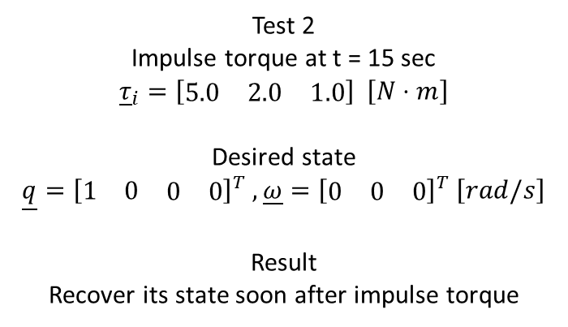
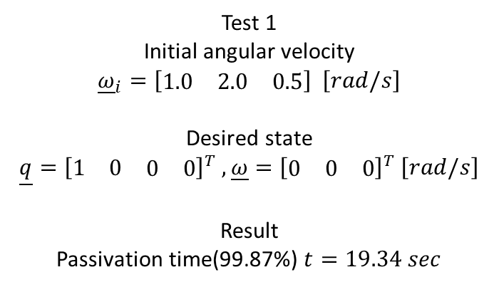
3. Experiment Result
Test 1
Initial angular velocity
$${\underline{ω}}_{i}=\left[\begin{matrix}1.0 & 2.0 & 0.5\end{matrix}\right] \left[rad/s\right]$$
Desired state
$$\underline{q}={\left[\begin{matrix}1 & 0 & \begin{matrix}0 & 0\end{matrix}\end{matrix}\right]}^{T} ,\underline{ω}={\left[\begin{matrix}0 & 0 & 0\end{matrix}\right]}^{T} \left[rad/s\right]$$
Result
Passivation time(99.87%) $t=19.34 sec$
Test 2
Impulse torque at t = 15 sec
$${\underline{τ}}_{i}=\left[\begin{matrix}5.0 & 2.0 & 1.0\end{matrix}\right] \left[N⋅m\right]$$
Desired state
$$\underline{q}={\left[\begin{matrix}1 & 0 & \begin{matrix}0 & 0\end{matrix}\end{matrix}\right]}^{T} ,\underline{ω}={\left[\begin{matrix}0 & 0 & 0\end{matrix}\right]}^{T} \left[rad/s\right]$$
Result
Recover its state soon after impulse torque
Fig.7. Disturbance test for trained model validation – test 1 and test 2

Slide 10
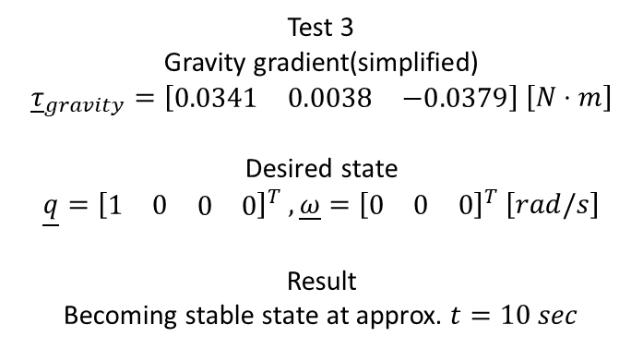
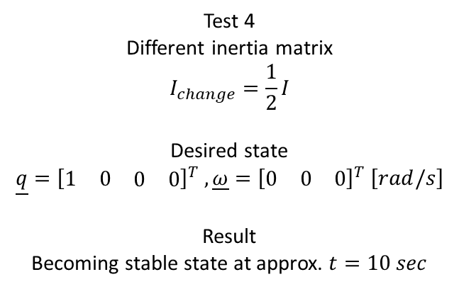
3. Experiment Result
Test 3
Gravity gradient(simplified)
$${\underline{τ}}_{gravity}=\left[\begin{matrix}0.0341 & 0.0038 & −0.0379\end{matrix}\right] \left[N⋅m\right]$$
Desired state
$$\underline{q}={\left[\begin{matrix}1 & 0 & \begin{matrix}0 & 0\end{matrix}\end{matrix}\right]}^{T} ,\underline{ω}={\left[\begin{matrix}0 & 0 & 0\end{matrix}\right]}^{T} \left[rad/s\right]$$
Result
Becoming stable state at approx. $t=10 sec$
Test 4
Different inertia matrix
$$I_{change}=\frac{1}{2}I$$
Desired state
$$\underline{q}={\left[\begin{matrix}1 & 0 & \begin{matrix}0 & 0\end{matrix}\end{matrix}\right]}^{T} ,\underline{ω}={\left[\begin{matrix}0 & 0 & 0\end{matrix}\right]}^{T} \left[rad/s\right]$$
Result
Becoming stable state at approx. $t=10 sec$
Fig.8. Disturbance test for trained model validation 2

Slide 11
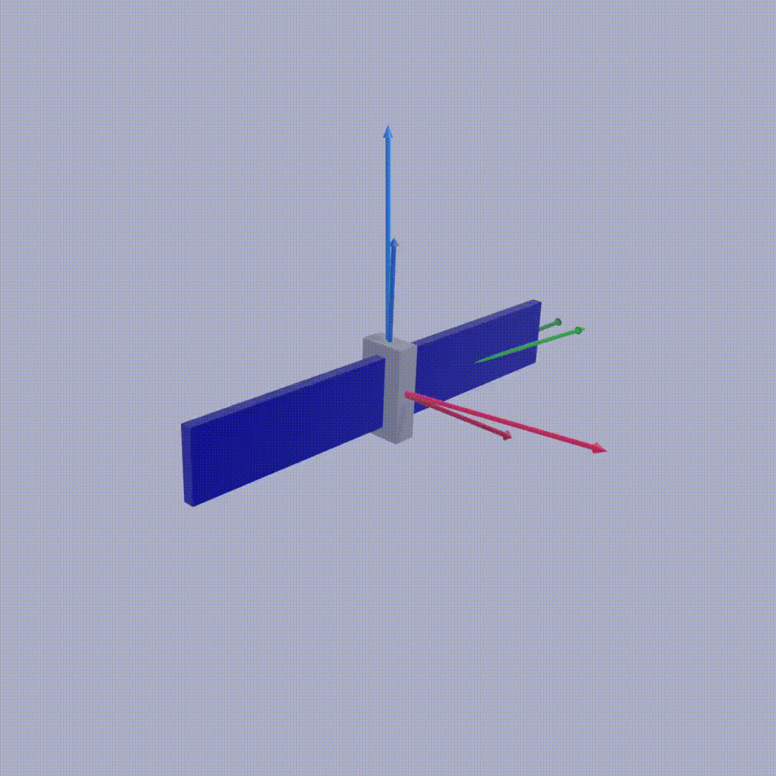
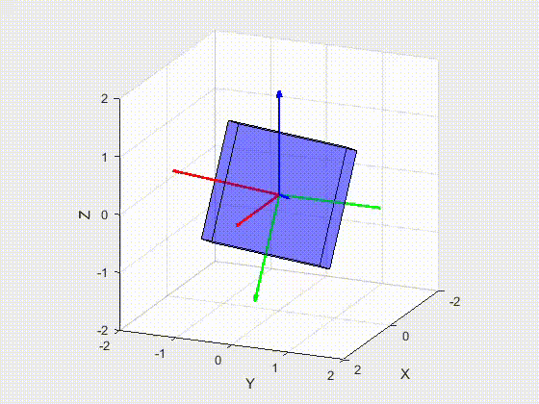
3. Experiment Result Visualization
Fig.9. Visualization result from author(test 1)
Fig.10. Visualization result by User (arbitrary initial angle)

Slide 12
4. Summary
Summary
일반적인 강화학습 기법들과 달리 Dynamics와 Kinematics로 부터 state를 관측함.
산업 표준 시간인 1/240초를 사용하여 time critical control에 부합한 제어가
가능하다는 것을 보임.
TD3 architecture를 활용하여 continuous action를 생성
외란(disturbance)에 적절히 반응할 수 있는 자세 제어 명령이 인공지능을 통해서 충분히
생성될 수 있음을 보임
DRL이 우주 환경에서도 활용될 수 있는 가능성을 시사
Expected Future work
Multi-body Dynamics problem
Single rigid body problem에서 multi-body dynamics로의 확장
AI control simulation for satellite
자세 제어 뿐만 아니라 rendezvous docking/navigation 등의 임무에도 AI를 활용
DRL 뿐만 아니라 CNN(Convolutional neural network), PINN(physics-informed neural network) 등의 활용 모색
Auto-control satellite의 지향점

Slide 13
Reference
1) Elkins, Jacob, Rohan Sood, and Clemens Rumpf. "Adaptive continuous control of spacecraft attitude using deep reinforcement learning." Proceedings of. 2020.
2) Liu, Shuchang, et al. "Application of deep reinforcement learning in reconfiguration control of aircraft anti-skid braking system." Aerospace 9.10 (2022): 555.
3) Elkins, Jacob, Rohan Sood, and Clemens Rumpf. "Adaptive continuous control of spacecraft attitude using deep reinforcement learning." Proceedings of. 2020.

